Slide 1
MySQL
Introduction

Slide 2
What is MySQL?
MySQL is a widely used relational database management system (RDBMS).
MySQL is free and open-source.
MySQL is ideal for both small and large applications.

Slide 3
What is MySQL?
MySQL is very fast, reliable, scalable, and easy to use
MySQL is cross-platform
MySQL is compliant with the ANSI SQL standard
MySQL was first released in 1995
MySQL is developed, distributed, and supported by Oracle Corporation

Slide 4
Who Uses MySQL?
Huge websites like Facebook, Twitter, Airbnb, Booking.com, Uber, GitHub, YouTube, etc.
Content Management Systems like WordPress, Drupal, Joomla!, Contao, etc.
A very large number of web developers around the world

Slide 5
What is RDBMS?
RDBMS stands for Relational Database Management System.
RDBMS is a program used to maintain a relational database.
RDBMS is the basis for all modern database systems such as MySQL, Microsoft SQL Server, Oracle, and Microsoft Access.
RDBMS uses SQL queries to access the data in the database.

Slide 6
What is a Database Table?
A table is a collection of related data entries, and it consists of columns and rows.
A column holds specific information about every record in the table.
A record (or row) is each individual entry that exists in a table.

Slide 7
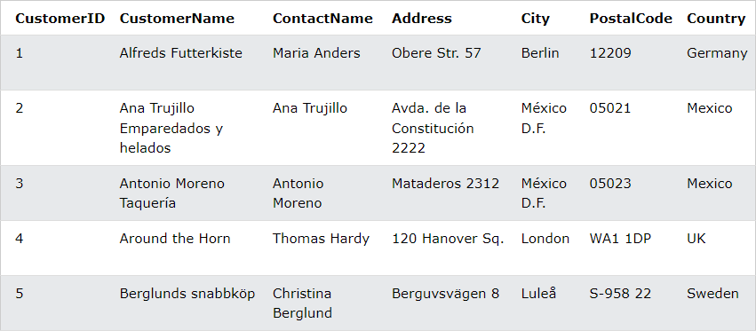
What is a Database Table?
Look at a selection from the Northwind "Customers" table:

Slide 8
What is a Relational Database?
A relational database defines database relationships in the form of tables. The tables are related to each other - based on data common to each.
Look at the following three tables "Customers", "Orders", and "Shippers" from the Northwind database:

Slide 9
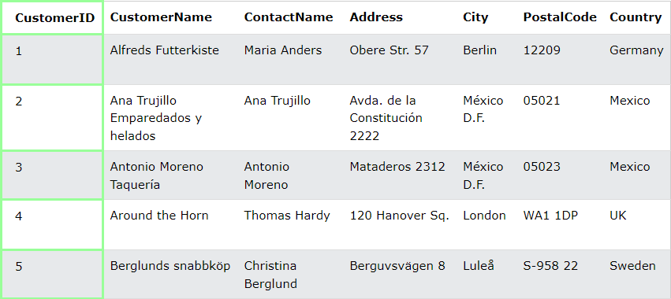
What is a Relational Database?
Customers Table

Slide 10
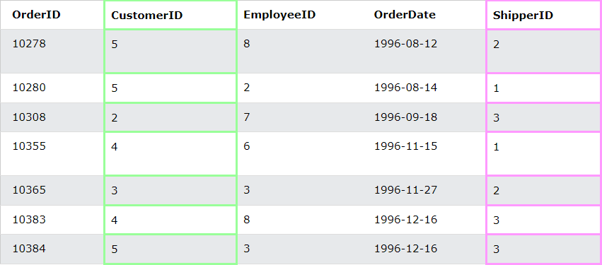
What is a Relational Database?
The relationship between the "Customers" table and the "Orders" table is the CustomerID column:
Orders Table

Slide 11
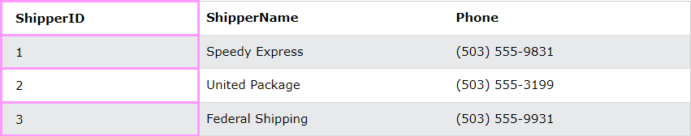
What is a Relational Database?
The relationship between the "Orders" table and the "Shippers" table is the ShipperID column:
Shippers Table

